Slide 1

Bank Loan Analysis Data Analytics Project

Slide 2
overview
Welcome to our Bank Analytics Project presentation. In today's dynamic financial landscape, data-driven insights are paramount for banks to thrive. Our project aims to delve into the depths of banking data to uncover actionable insights, empowering decision-makers to make informed strategies and seize opportunities. Let's embark on this journey together as we explore the realm of bank analytics.

Slide 3
KpI’S
Year wise Loan Amount Status
Grade And Subgrade wise Revolving Balance
Total Payment For Verified Status Vs Non-Verified Status
State wise and Month wise Loan Status
Home Ownership Vs Last Payment Date Status

Slide 4
Key Metrics for KPI’s Requirement
Total Funded
Amount
$445.6 M
Total Payment
Received
$482.7M
Total Revolving Balance
$531.5M
Total Loan Applications
39.7K
Average DTI
13.3%
Avg Interest Rate
12.0%

Slide 5
TABLE OF CONTENTS
1
2
3
Year Wise Loan Amount Status
Tool Used Power BI & MYSQL
Grade And Subgrade Wise Revolving Balance
Tool Used Tableau
Total Payment For Verified Status Vs Non-Verified Status Tool Used Power Bi
4
5
6
State Wise And Month Wise Loan Status
Tool Used Power BI and MYSQL Workbench
Home Ownership Vs Last Payment Date Status
Tool Used Excel
Dashboards Using Excel, Tableau and Power BI
7
Conclusion

Slide 6

YEAR WISE LOAN AMOUNT STATUS Tools Used POWER BI & MYSQL
1

Slide 7
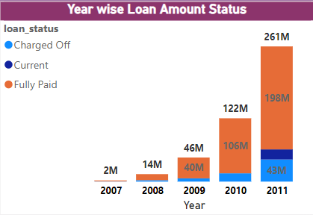
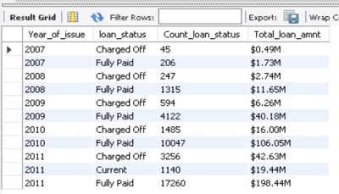
1. Year Wise Loan Amount Status.
CONCLUSIONS
In this KPI, it is clearly shown in chart that as we go from year 2007 to 2011 the loan amount is rapidly increasing and it increased to $261 M in 2011 and lowest in the year 2007 that is $2M.
We have the maximum fully paid amount in the year 2011 that is $198 M and followed by the year 2010. In the year 2010, the loan amount for the fully paid customers is $ 106M and the lowest in the year 2007 is $1M.
The loan amount which is not fully repaid are considered as charged off loans and it is maximum in the year 2011 which is $42.6M which is followed by the year 2010 and lowest in the year 2007 which is $488K.
Customers who are repaying their loan on regular basis hold the current status and we have the current loan status amount only in the year 2011 which is $ 19.4M.
So, we can conclude that fully paid customers are slightly greater than the charged off customers and current status holding customers are very less as compared to both status.
There are maximum count of fully paid status which is 32.9K , charged off status count is 5.6K and lowest count of current status is 1.1K.
By analysing the year wise loan amount status, bank should take actions like effective recovery strategies, proactive communication and Improved risk assessment techniques for reducing charged off loans for bank’s financial health and performance.

Slide 8

2
Grade And Sub Grade Wise Revolving Balance Tools Used Tableau

Slide 9
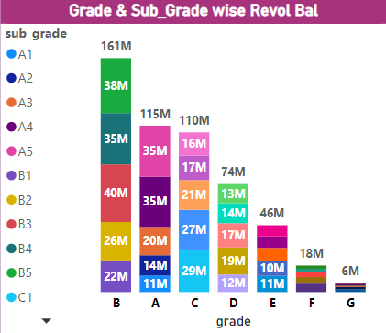
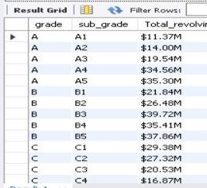
2. Grade And Subgrade Wise Revolving Balance.
In this Grade and subgrade wise revolving balance we can notice Grade B has more revolving balance then any other grades & Grade G has very low revolving balance.
The average revolving balance is higher in the ‘grade G’ its around 105K and the maximum reaches in the ‘sub-grade G4’ that is 25K, Same like the average lower revolving balance is in ‘grade A’ its around 55K and the minimum reaches in the ‘sub-grade A2’ that is 9k.
For further analysis we can say that Grade A has second highest revolving balance and in which sub-grade A4 and A5 have maximum revolving balance which is 35M approx.
So Here we analyse that maximum no. of customers in Grade ‘B’ and minimum no. of customers in Grade ‘G’ .
Here we conclude that we should encourage responsible credit utilization to minimize revolving balances across all loan grades.
We should encourage our customers to pay their Loan payments on time (at the end of each month) so that we can reduce revolving balances across all loan grades

Slide 10

3
Total Payment For Verified Status Vs Non-Verified Status Tool Used Power BI

Slide 11
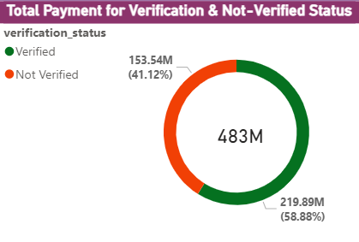

3. Total Payment For Verified Status VS Non Verified Status.
Total Payment Volume:
The total payment volume for both verified and non-verified statuses combined is 219.9 Million + 153.5 Million = 482.7 Million.
Percentage of Payment from Verified Users:
% from verified users = (219.9 Million / 482.7 Million) * 100 ≈ 58.9%.
Percentage of Payment from Non-Verified Users:
% from non-verified users = (153.5 Million / 482.7 Million) * 100 ≈ 41.1%.
Comparative Analysis:
Verified users contribute a larger portion of the total payment volume compared to non-verified users, with approximately 58.72% of the total payment volume coming from verified users and 41.28% from non-verified users.
Verification Impact:
The data suggests that having a verified status may positively impact payment behavior, as verified users contribute a larger share of the total payment volume.
Future Strategies:
Based on this analysis, it may be beneficial to focus on increasing the number of verified users or encouraging non-verified users to verify their accounts, as it could potentially lead to increased payment volumes.

Slide 12

State Wise And Month Wise Loan Status Tool Used Power BI
4

Slide 13
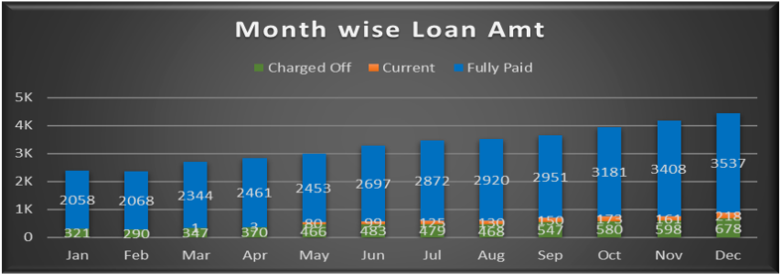
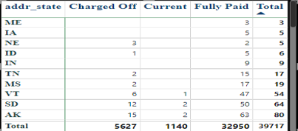
4. State wise and month wise loan status.
Our loan data shows that December had the highest loan activity. In December, the total loan disbursed in 3.5K Customers (for current date Fully Paid), with 218 Customers (for the current date) charged off and 687 Customers are currently paying.
Conversely, February had the lowest overall loan activity. While the fully paid Customer in February are2068, the charged off Customer in February was significantly lower at 290.
Analysing loan data by state reveals California (CA), New York(NY) and Florida(FL) as the leading consumer with the following breakdown:
Fully Paid Loans: 5.8K(CA),3.2K(NY), 2.9K(FL)
Charged Off Loans: 150(CA),114(NY),85(FL)
Currently Paying Loans: 1.1K(CA),495(NY),504(FL)
Maine (ME), Lowa (IA) and NE exhibits the lowest loan consumption at 3(Fully Paid), 5(Fully Paid) and 3(Charged Off) & 2 (Fully Paid) Customers.

Slide 14

Home Ownership Vs Last Payment Date Status Tool Used Excel
5

Slide 15
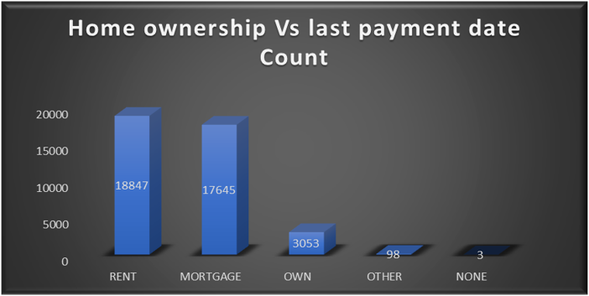
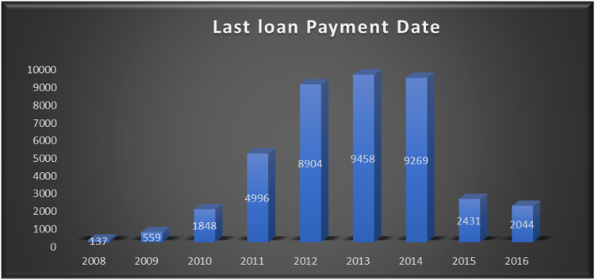
4. Home ownership Vs last payment date status.
A key finding from our home ownership data analysis is the prevalence of renters, constituting roughly 18.8 thousand customers.
This highlights a significant segment of the population that may be interested in future homeownership opportunities.
Understanding the factors influencing their renting decisions can be crucial for developing targeted strategies to promote homeownership within this demographic.
"Other Home Ownership" category is noteworthy for having the fewest customers, with only 98 individuals.
This relatively small segment may represent a diverse group of ownership arrangements not captured by the standard categories. Further investigation into this category could potentially reveal valuable insights into alternative or emerging home ownership trends.
An analysis of last payment dates between 2008 and 2016 reveals that 2013 witnessed the highest loan repayment activity, with approximately 9.5K customers making their final payments.

Slide 16
Dashboards using Excel, tableau and power bi
6

Slide 17
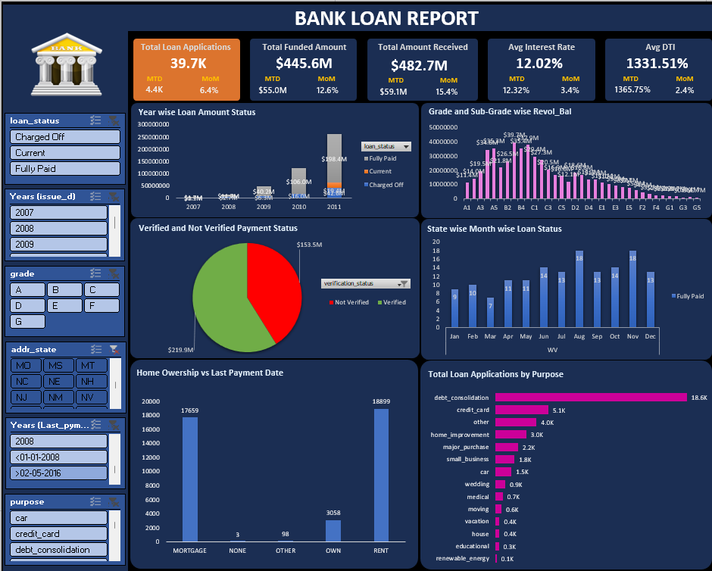
DashBoard Using Excel

Slide 18
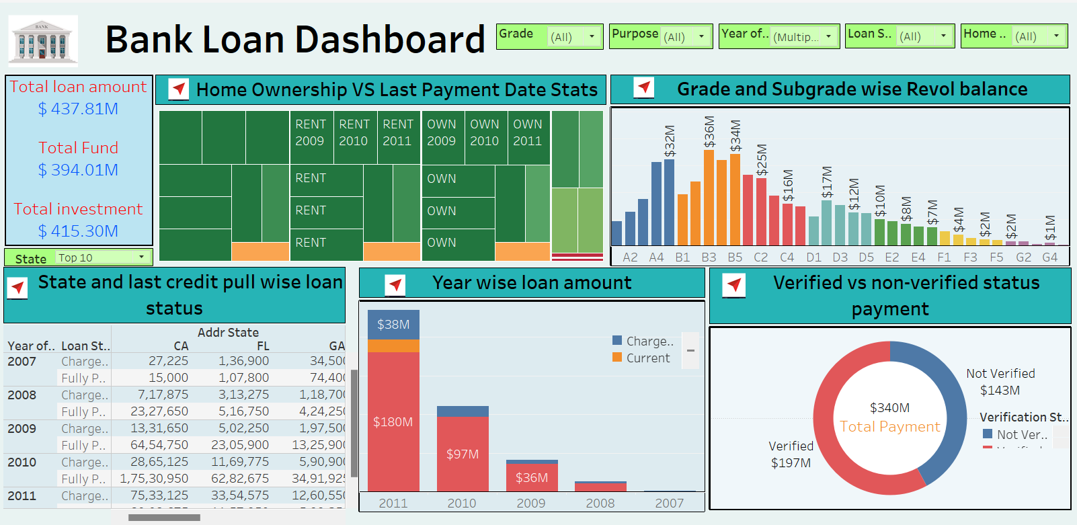
DashBoard Using Tableau

Slide 19
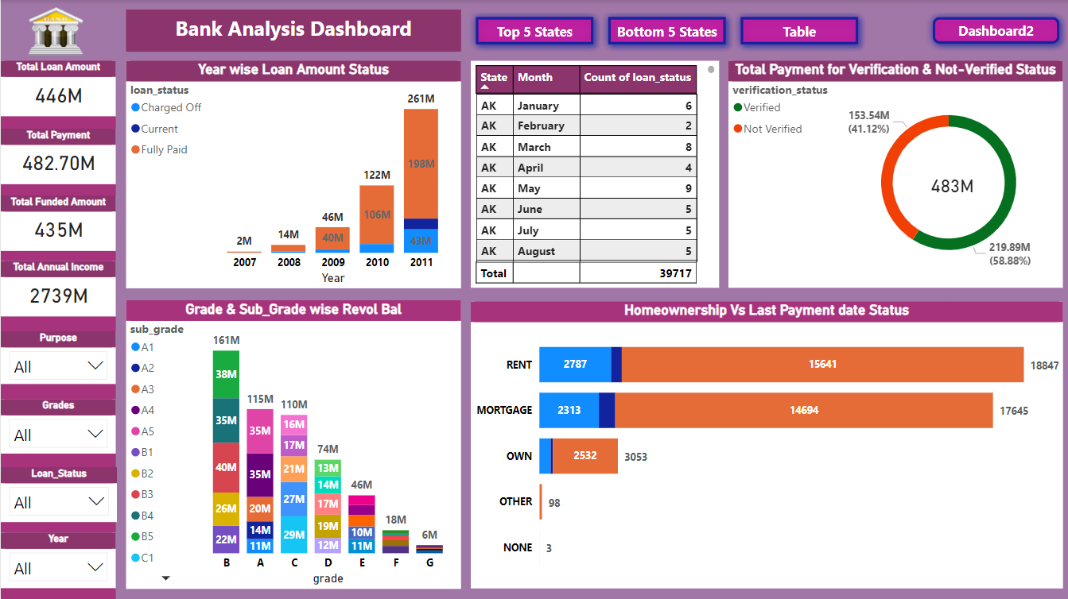
DashBoard Using Power BI

Slide 20
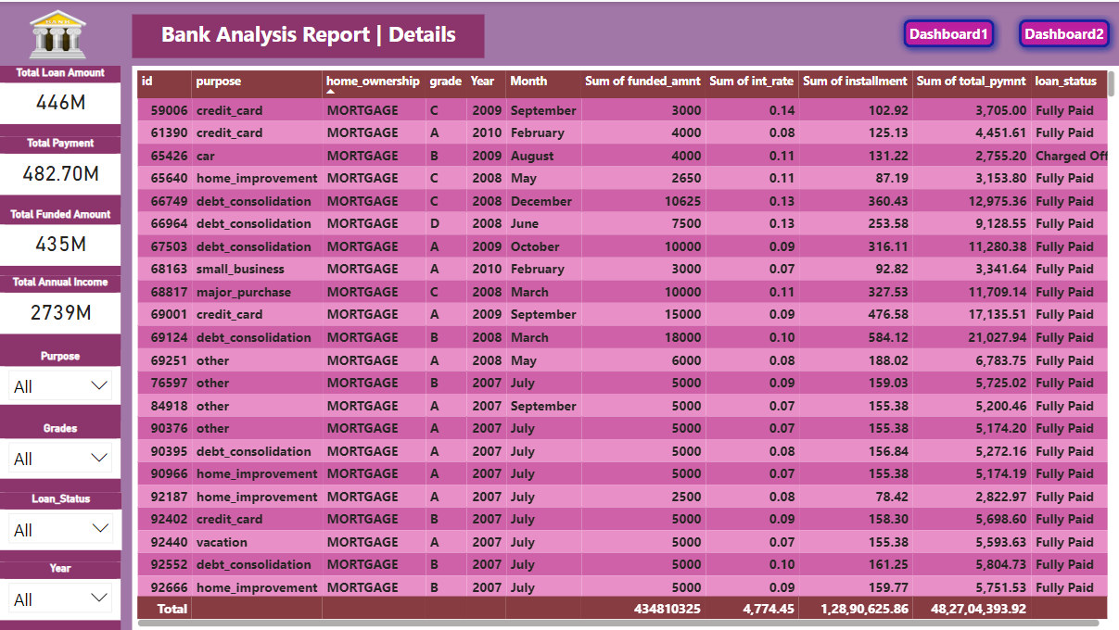
Details Grid View

Slide 21

conclusion
7

Slide 22
7. Conclusion
The conclusions from the Bank Loan Report Analysis Project based on the specified key performance indicators (KPIs):
1. Year wise Loan Amount Status: The project analyzed loan amounts over different years. It's essential to monitor trends in loan applications and disbursements to understand the bank's lending strategy and overall health of the loan portfolio.
2. Total Payment for Verified Status Vs. Non-Verified Status: By comparing payments for verified and non-verified loans, the project likely identified patterns related to borrower credibility. Verified loans may have higher payment compliance, while non-verified loans could exhibit varying payment behavior.
3. State and Month wise Loan Status: The project explored loan status variations across different states and months. This analysis helps identify regions with higher loan demand, seasonal patterns, and potential risk areas.
4. Grade and Subgrade wise Revolving Balance: Focusing on creditworthiness (grades and subgrades), the project likely assessed the revolving balances associated with different loan categories. This information aids in risk assessment and portfolio management.
5. Home Ownership Vs. Last Payment Date: The project might have investigated how home ownership status correlates with payment behavior. Understanding whether homeowners tend to make timely payments provides insights into loan performance.
Overall, this Bank Loan Report Analysis Project combined SQL for data manipulation and Power BI, excel and Tableau for visualization to create a comprehensive report. Stakeholders can use these insights to make informed decisions regarding loan applications, approvals, and risk management.

Slide 23

Thank you

